Slide 1


Slide 2
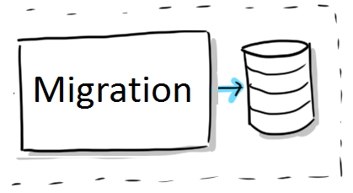
migration Lec 6
Generating Migrations
Migration Structure

Slide 3
Generating Migrations php artisan make:migration -h
Description:
Create a new migration file
Usage:
make:migration [options] [--] <name>
Arguments:
name The name of the migration
Options:
--create[=CREATE] The table to be created
related
php artisan migrate //Running Migrations
php artisan migrate:fresh //Drop all tables and re-run all migrations
php artisan migrate:install //Create the migration repository
php artisan migrate:refresh //Reset and re-run all migrations
php artisan migrate:reset //Rollback all database migrations
php artisan migrate:rollback //Rollback the last database migration
php artisan migrate:status //Show the status of each migration
EX suggestion
php artisan make:migration emp --create=cars
php artisan migrate --seed

Slide 4
Migration Structure
class CreateFlightsTable extends Migration {
/** * Run the migrations. * * @return void */
public function up() {
Schema::create(‘users', function (Blueprint $table) {
$table->increments('id');
$table->string('name');
$table->string('email')->unique();
$table->date(‘Bdate') ->nullable();
$table->integer('votes') ->unsigned();
$table->float('amount', 8, 2);
$table->boolean('confirmed')->default(true);
$table->integer(DNO');
$table->timestamps();
$table->foreign('DNO') ->references('DNO)->on(‘Depts') ->onDelete('cascade');
});
}
/** * Reverse the migrations. * * @return void */
public function down() {
Schema::drop(users');
}
}

Slide 5
Error : 1071 Specified key was to o long; max key length is 767 bytes
use Illuminate\Support\Facades\Schema;
public function boot() {
Schema::defaultStringLength(191);
}

